Slide 1

Searching for Signatures of Chaos in the Winds of Wolf-Rayet Stars
Khang M. Nguyen, Leihao Shi
Supervisor: Dr. Ian Stevens

Slide 2
Outline
Background
Wolf-Rayet Classifications
TESS
Research Objectives
Preliminary Results
Fitting Periodograms
Discussions
Future Plans
Summary

Slide 3
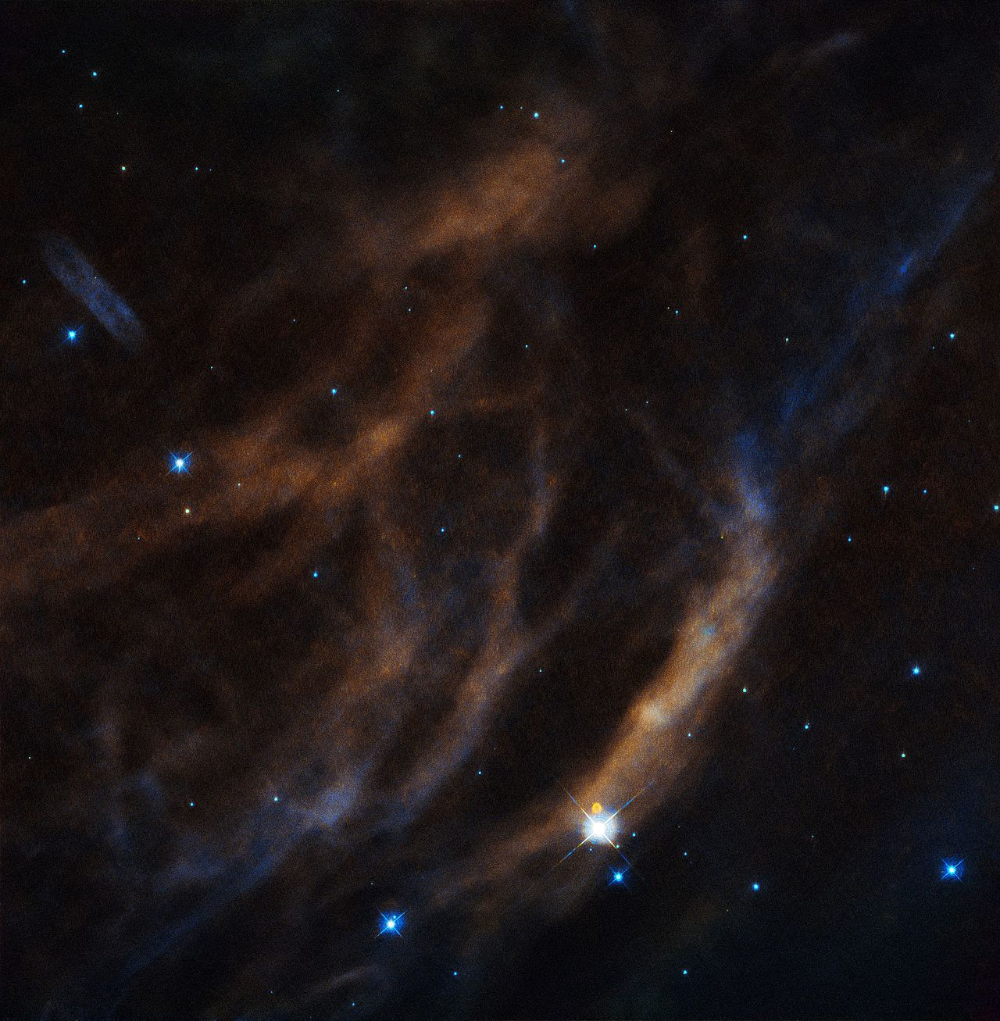
Background
Wolf-Rayet stars (WRs) are extremely massive stars (10-25 M⊙) with high mass loss rate via its stellar wind
Fast and dense stellar wind helps drive and quench star formations (Rate and Crowther, 2020)
Mass loss rate drives their evolution + final outcome (Steinle & Kesden, 2021)
Radiatively line-driven winds (+ rotation) is inherently unstable → Chaos
WR6 (EZ Canis Majoris) – by ESA/Hubble
Notes:
Notes:
1. (Point 2) … by ionising HII regions, dispersing leftover gas from star forming process
2. Mass loss rate is the key mechanism behind WR as they drive their evolutions and ultimately their end fate (BH/NS).
Understanding WR winds is important in understanding GW, pre-cursor conditions in forming BHs and/or BBHs
3. (Point 4) … and non-linear instabilities arise as a result. That is why we are expect there to be signatures of chaos to be found in WRs.
and non-linear instabilities arise as a result
(Optional: Rotations in WR clumpy winds (Chené et al., 2020), relevant with TESS data that can be detected, also important in final outcome of WR)

Slide 4
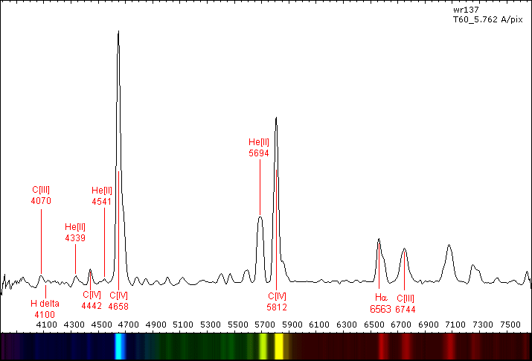
Wolf-Rayet Classifications
WR stars named on basis of strong broad emission lines in their spectra
Main classes include WN – nitrogen; WC – carbon; WO – oxygen
WN2-WN11 ; WC4-WC11 ; WO1-WO4
Additional spectral features added as suffixes to main classes (i.e. h, ha, w, b, d, etc…)
Spectrum of WR 137, a WC7 star (Sanders, A., 2012)
Notes:
Wolf–Rayet stars were named on the basis of the strong broad emission lines in their spectra, identified with helium, nitrogen, carbon, silicon, and oxygen, but with hydrogen lines usually weak or absent.
The two classes WN and WC were further split into temperature sequences WN5–WN8 and WC6–WC8. A WO sequence has also been separated from the WC sequence for even hotter stars where emission of ionised oxygen
Detailed modern studies of Wolf–Rayet stars can identify additional spectral features, indicated by suffixes to the main spectral classification:^{[21]}
h for hydrogen emission;
ha for hydrogen emission and absorption;
o for no hydrogen emission;
w for weak lines;
s for strong lines;
b for broad strong lines;
d for dust (occasionally vd, pd, or ed for variable, periodic, or episodic dust).

Slide 5
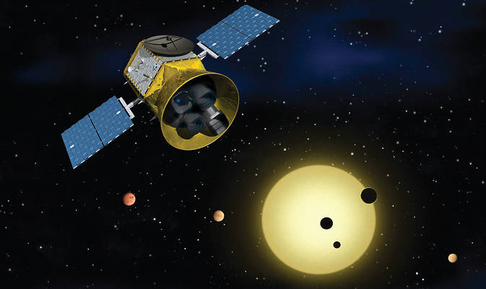
TESS
Image courtesy of NASA
Transiting Exoplanet Survey Satellite
TESS has a 90° × 24° FOV with 4 main cameras and
performs observations of stars in the 600–1000 nm range (Ricker et al. 2015)
Average observing interval on a specific field is ∼27 days, with either a 2 or 30 minute cadence data in its main mission.
Ideal for observing short-term variability winds of WRs in the [0.03, 350] days⁻¹ frequency domain.
Our focus in this project is on the 2-min cadence data of WR stars taken from the Galactic Wolf Rayet Catalogue (Rosslowe & Crowther, 2005)
Notes:
TESS is a space telescope for NASA's Explorer program, designed to search for exoplanets using the transit method (with an area hundreds of times the area that of Kepler’s) launched in 2018.
Accurate photometry makes this satellite ideal for observing
short-term variability in the winds of WR stars in the ν ä [0.03,
350] days−1 domain.

Slide 6
Research Objectives
Investigating sample of bright WRs observed by TESS (~100 light curves total)
Primary goal - characterise the nature of variability and look for low-order chaos signatures in stellar winds
Further investigate winds using non-linear dynamical tools and techniques (mutual information, permutation entropy, Lyapunov exponents, etc..)
Notes:
Speak briefly about TESS measurements, sector – 27 days, cadence 2-min

Slide 7
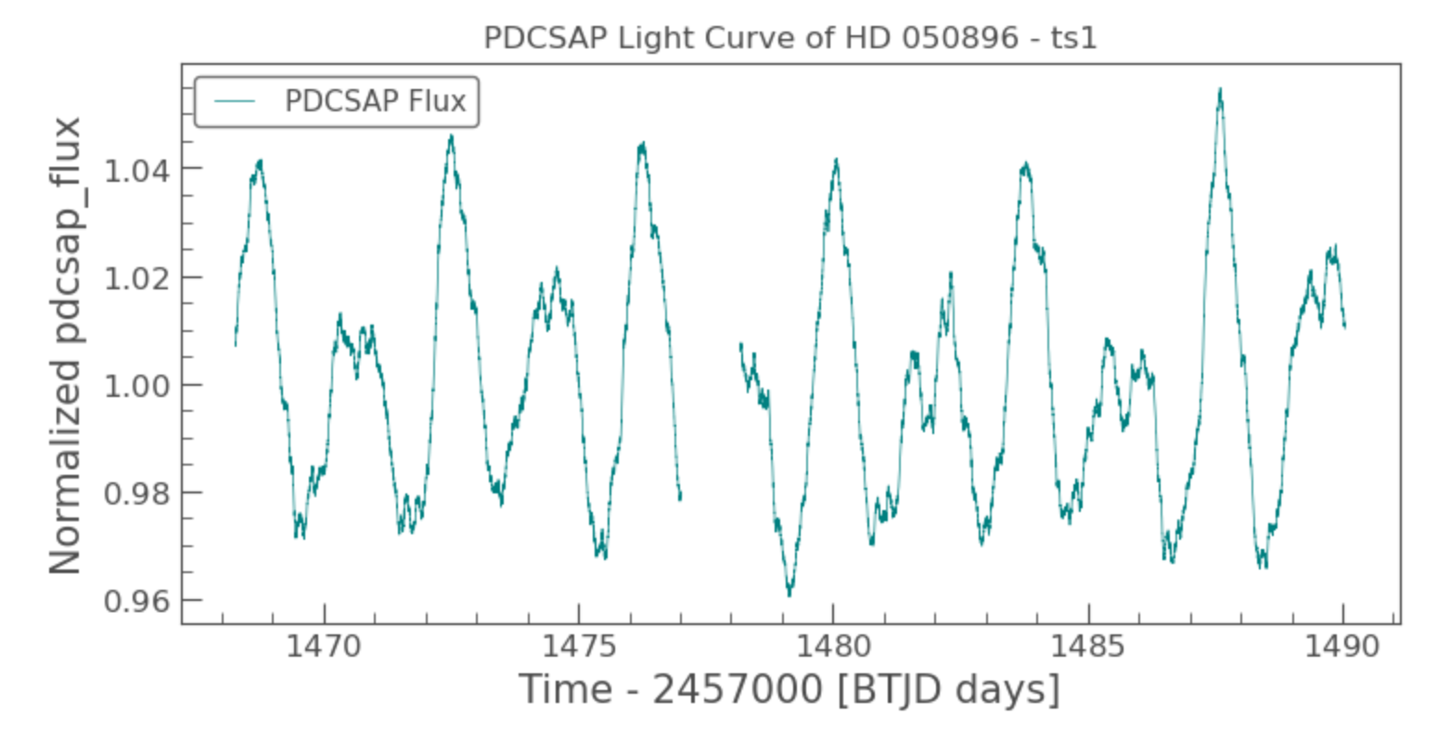
Notes:
Mention briefly that this is an example of a PDCSAP light curve data from TESS of WR6, before going into prelim-results

Slide 8
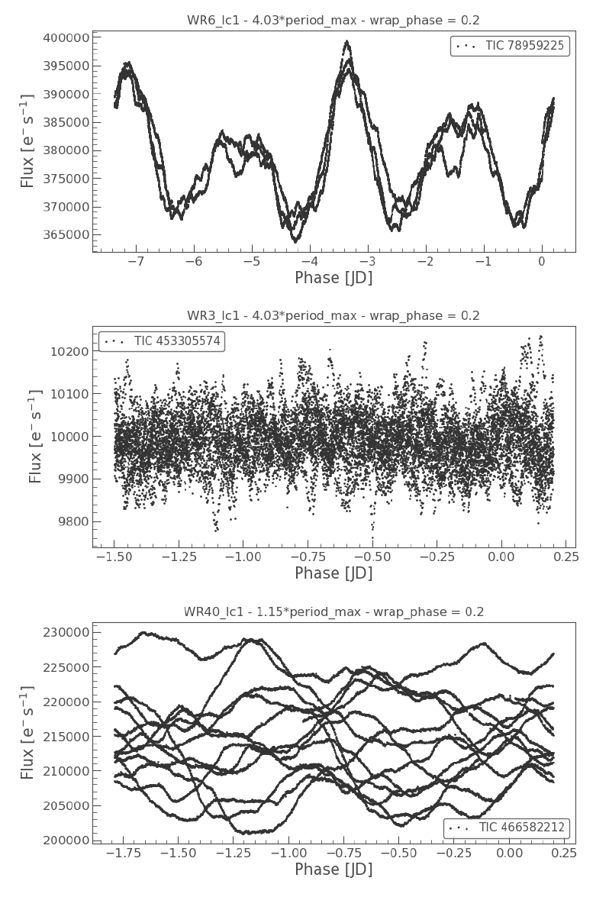
Preliminary Results –WR6, WR3, WR40
Proceed to fold its light curve by multiplying its period-at-max-power and applying a wrapping phase.
For WR6, a periodic behaviour can be observed (for all 3 of its available datasets)
For WR3, flux is one order of magnitude below WR6 & WR40 – very noisy data
For WR40, no discernible periodic behaviour and most likely to be chaotic (Ramiaramanantsoa et al., 2019)
Notes:
Results of WR3 and WR40 are in stark contrast to result of WR6.
WR40 already looks like this prior to folding and phase wrapping.
Conclusion of these prelim results (so far)
WR6 is a good non-chaotic candidate as it is shown that it is quite a tame WR
WR3 presents us a challenge of picking out the chaotic science from this noisy data
WR40 is a unique example for the latter stage of the project where we start exploring deeper into WRs chaotic nature and characterise a sample of them.

Slide 9
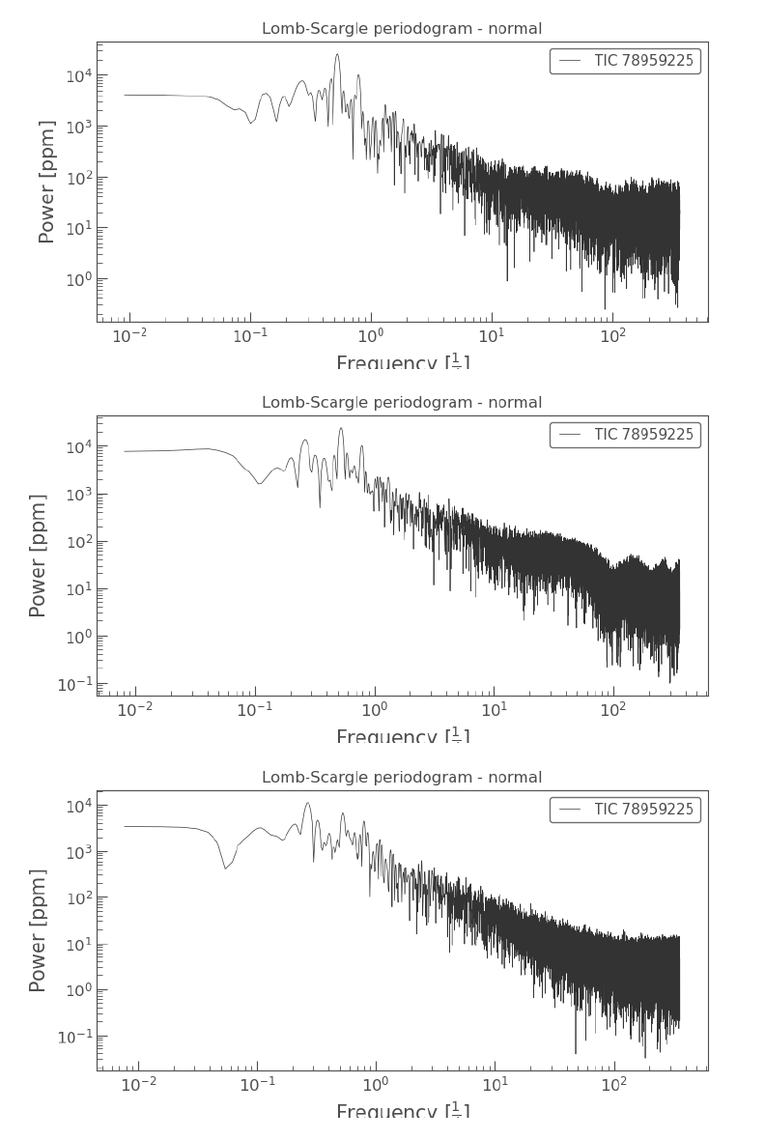
Preliminary Results – WR6
Known measured period of its apparent magnitude variation - 3.7 days (St. Louis et al., 1995)
TESS datasets showed 2 different period-at-max-power (3.7 & 1.8 days)
Tests for significance needed to verify peaks existence (Vaughan (2004), Zhou & Sornette (2001))
Notes:
Performed Lomb-Scargle periodogram of our stars. Usually yields one max-power period per time series. But for WR6, there is 2 max-power period. Unsure why. Could be how the Fourier transform when doing LS spectrum is confuses itself when processing the signal (if asked, tell them about the 2-peak example that Ian demonstrated to you).

Slide 10
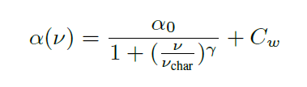
Fitting Periodograms
Amplitude spectrum function described by Bowman et al. (2019)
α₀ represents the amplitude at a frequency of zero
γ is the logarithmic amplitude gradient
ν_{char} is the characteristic frequency, which is the inverse of the characteristic timescale, τ , of stochastic variability present in the light curve such that ν_{char} = (2πτ )⁻¹
C_{w} is a frequency independent (white) noise term (Blomme et al., 2011)
We proceed to utilise the Bayesian Markov-Chain-Monte-Carlo (MCMC) method to fit this amplitude spectrum function to our Lomb-Scargle periodograms
Notes:
white noise is a random signal having equal intensity at different frequencies, giving it a constant power spectral density.
Many astrophysical sources show erratic, aperiodic brightness fluctuations with steep power spectra. This type of variability is
known as red noise.

Slide 11
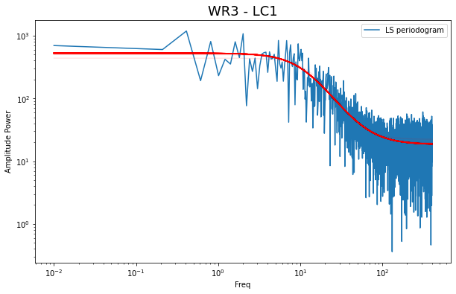
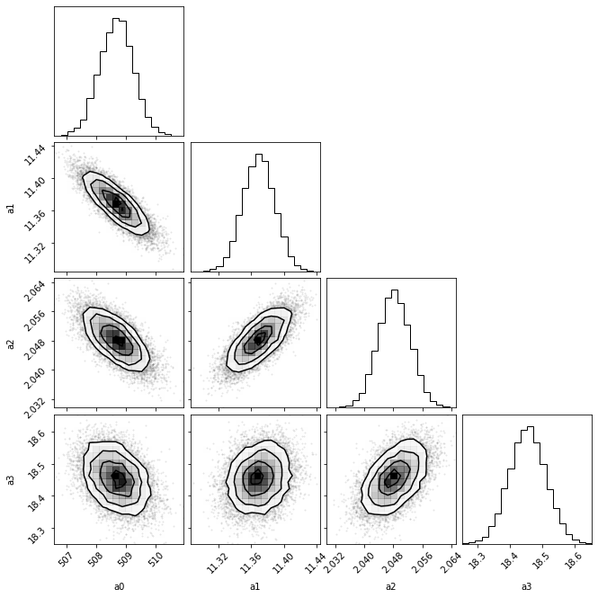

Slide 12
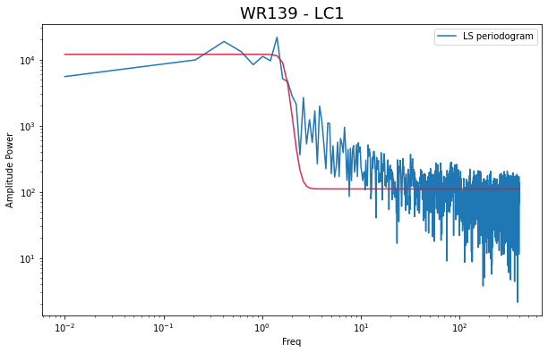
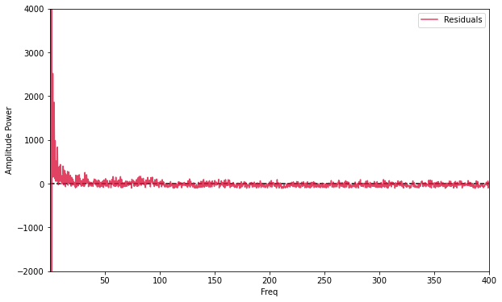
Notes:
Justifications for shortening the data and re-bin of data if necessary to obtain better fit

Slide 13
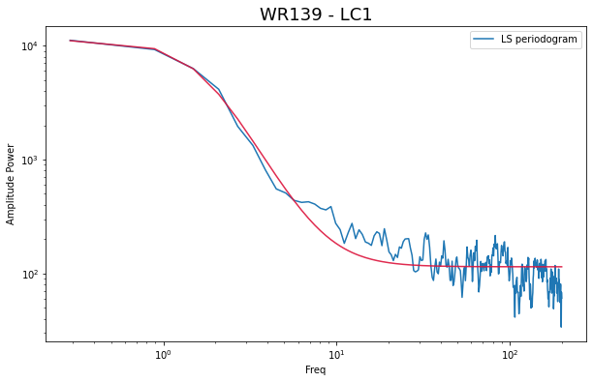
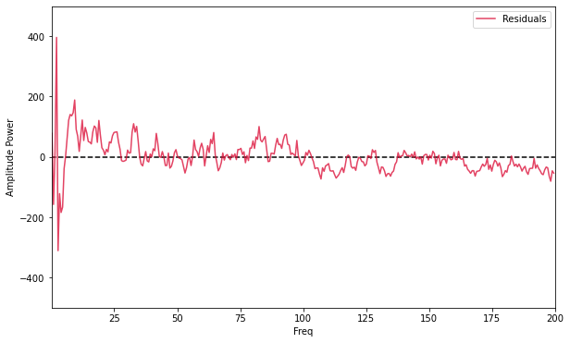
Notes:
Justifications for shortening the data and re-bin of data if necessary to obtain better fit

Slide 14
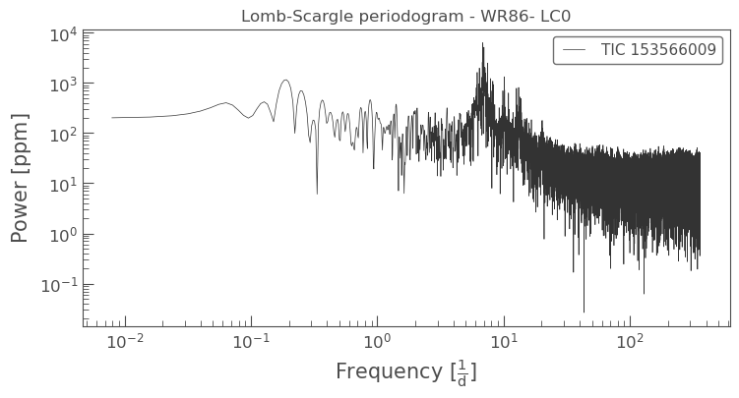
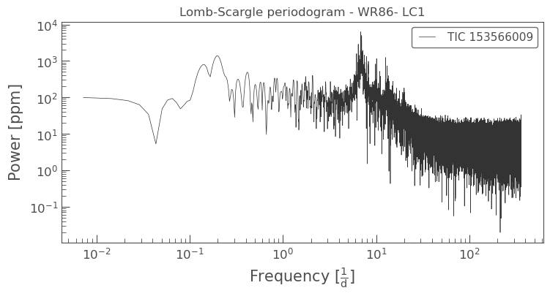
A few interesting stars…

Slide 15
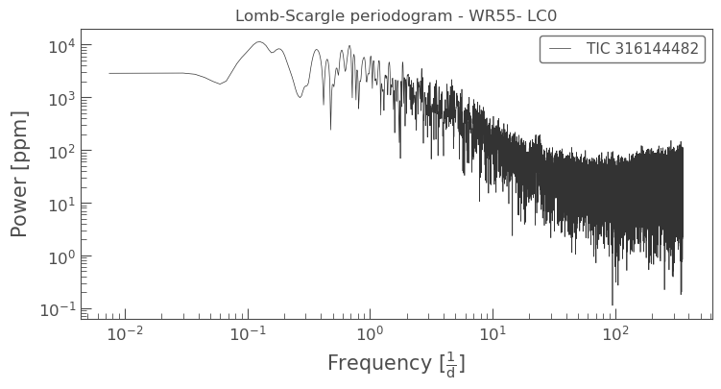
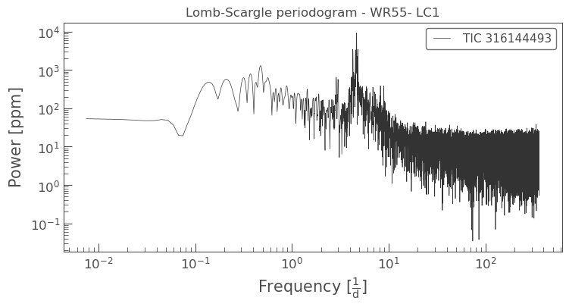
A few interesting stars…

Slide 16
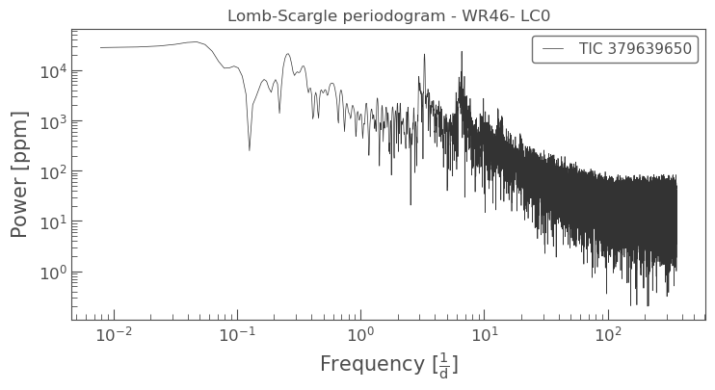
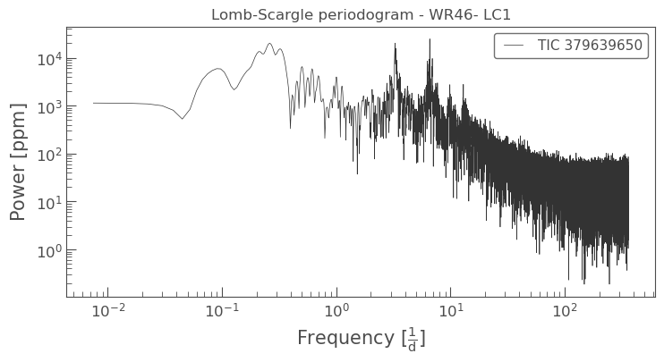
A few interesting stars…

Slide 17
Discussions
Vaughan (2004) discusses tests of significance of periodic signals in red noise data. Zhou & Sornette (2001) implements similar tests for specifically Lomb-Scargle periodograms using MCMC.
Comparing fitted parameters with stellar parameters such as effective temperature, luminosity, mass, etc..
Differs between spectral classes (?)
Notes:
Zhou & Sornette (2001) discusses tests of significance for peaks using LS and MCMC

Slide 18
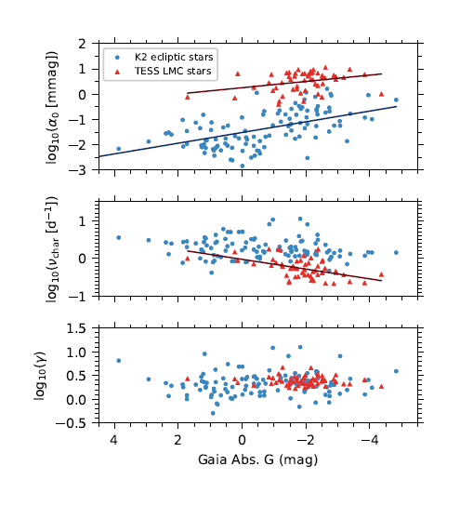
Relationship between intrinsic stellar brightness and characteristic parameters from amplitude spectrum fitting (Bowman et. al, 2019)
Notes:
Figure 4: Relationship between intrinsic stellar brightness and IGW morphology. The
pairwise correlation between the Gaia absolute G-band magnitudes and the fit parameters 0,
char and for the K2 and TESS samples are shown as blue circles and red triangles, respectively.
Significant correlations (p < 0:02) determined from a two-tailed linear regression are shown as
solid lines for each sample.

Slide 19
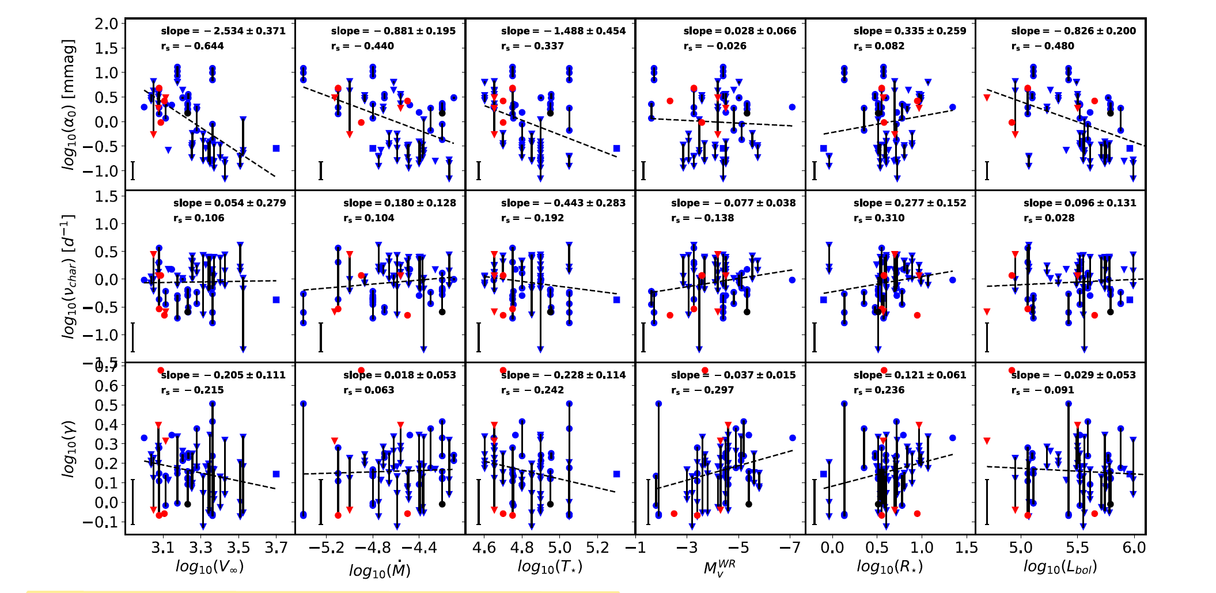
WR stars without signs of H in their spectrum, fitted parameters of the red-noise component as a function of various wind and stellar parameters (Lenoir-Craig et al., 2022)
Notes:
Figure 6. For the sample including WR stars without signs of H in their spectrum, fitted parameters of the red-noise component, α0, νchar, and γ as a function of
various wind and stellar parameters. Blue points are for TESS data, black for BRITE and red for MOST. The different data sets of individual stars observed by the same telescope are linked by black lines. Inverted triangles are for WC stars, and filled circles are
for WN stars.
The slope of the fitted straight line together with its error is given in the top-right corner of each panel along with the Spearman correlation coefficient, rs.
Paper found correlations between photometric variability with terminal velocity of the winds, different correlations are also found for different spectral classes of WRs (WNh)

Slide 20
Future Plans
Finding trends in fitted parameters with stellar parameters (Bowman et al., 2019)
Testing significance of peaks observed in Lomb-Scargle periodograms (Zhou & Sornette, 2001)
Using TISEAN software to investigate wind following methods applied by Phillipson et al. (2018, 2020).
Decision trees to detect chaotic signals in noisy measurements (Toker et al., 2019)
Permutation entropy & artificial neural networks to distinguish chaotic and stochastic signals (Boaretto et al., 2021)
Notes:
Sample of approx. 60 WRs with 2-min cadence data obtained and ready to be deployed for the following steps…
look for trends in fitted params with stellar params (t_eff, L, stellar mass) – first point
End of presentation!

Slide 21
Summary
Wolf-Rayet stars have very dense, violent radiatively-driven winds making them inherently unstable → signatures of chaos expected
Analysis, testing and fitting models to examine each star’s periodogram and characterising their variability
Using these fitted parameters to investigate correlations to any stellar properties
In future, using what we’ve learnt about our stars to then proceed to delve deeper into its winds and find their traces of chaos

